Slide 1
Advance Track Project
BY- ARYAN CHOUDHARY(170152)
MENTOR - DHAWAL UPADHYAY
INSTRUCTOR IN CHARGE - Purushottam Kar

Slide 2
Problem
I need a tool that can do the task of online ide.
Which I can use before submitting my solution on online platform like codeforces, etc.
To check the validity of my solution.

Slide 3
Problem
And protect my source code, because protection of source code is most important for a programmer.
To avoid being caught in plagiarism, which sometimes happens when we forget to make our code private.

Slide 4
Problem
https://discuss.codechef.com/questions/18669/what-does-codechef-do-to-prevent-cheating

Slide 5
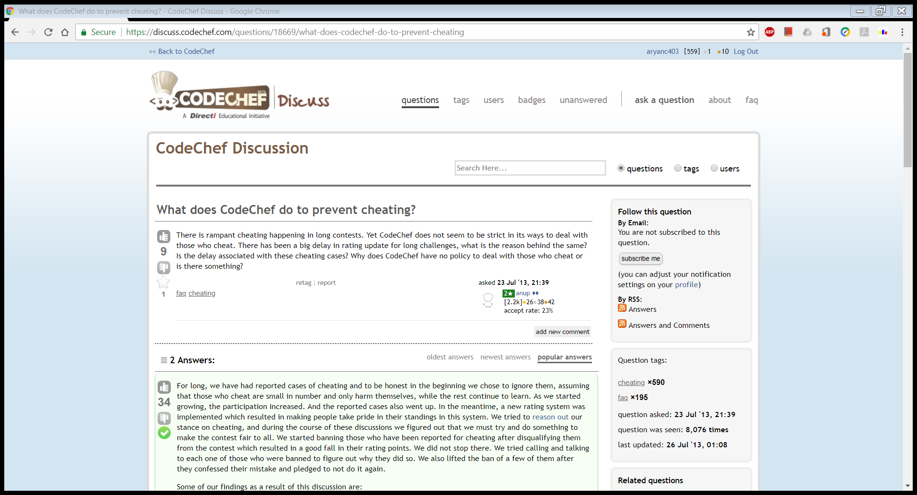

Slide 6
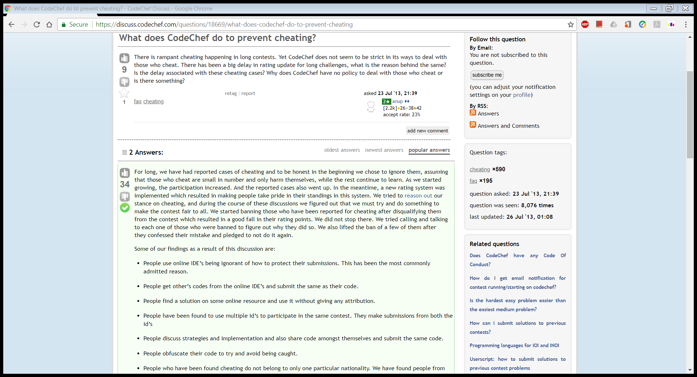

Slide 8
So, I present to you my project idea.

Slide 9
Solution
Although there are may tools available online to solve this problem.
I want to have my own software to serve this purpose.

Slide 10
Project Idea Credits -

Slide 11
Project Idea Credits -
They have already released full featured application for public release (4 years ago).
http://codeforces.com/blog/entry/13141 (Blog).
https://github.com/dj3500/hightail (Original application is created in Java).

Slide 12
Project Idea Credits -
And My mentor DHAWAL UPADHYAY.
For suggesting me this project.

Slide 13
Mid Term Status -

Slide 14
Mid Term Status -
Front End Task Completed.
Added Buttons for each task.
Added data grid.
Added functionality of Browse Button.
Added functionality of Fetch Button(Partial).

Slide 15
Mid Term Status -
Web Scrapper.(Task Completed).
Until now My Project can fetch Sample Input / Output and add then in a list.
Writing Sample Input / Output to file was not completed.

Slide 16
End Term Status -

Slide 17
End Term Status -
Completed Back end.
Able to write Sample Input / Output to file.
Added separate file for Result.

Slide 18
End Term Status -
I was told to look at possibilities of using Powershell/Cmd –
To speed up task.
And run multiple Testcases at a time.
And To deal with stdin and stdout of program.

Slide 19
End Term Status -
When Writing Entries in Data Grid Showed error.
TO do this as I was suggested during mid term.
To use some other function. Done.

Slide 20
Demo
ScreenShots.

Slide 21
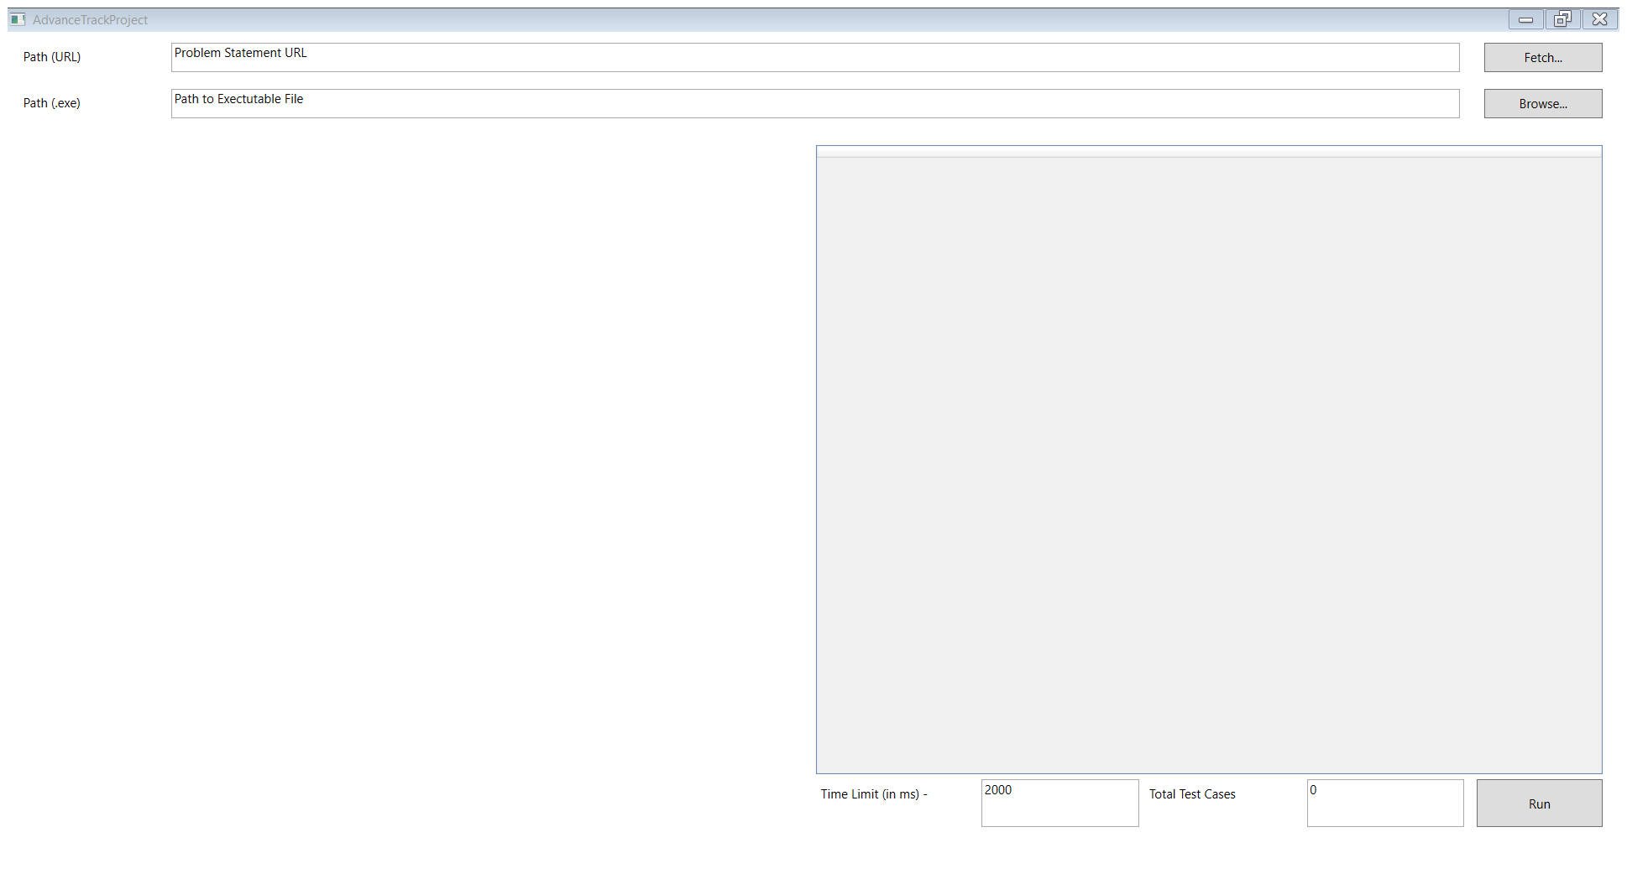

Slide 22
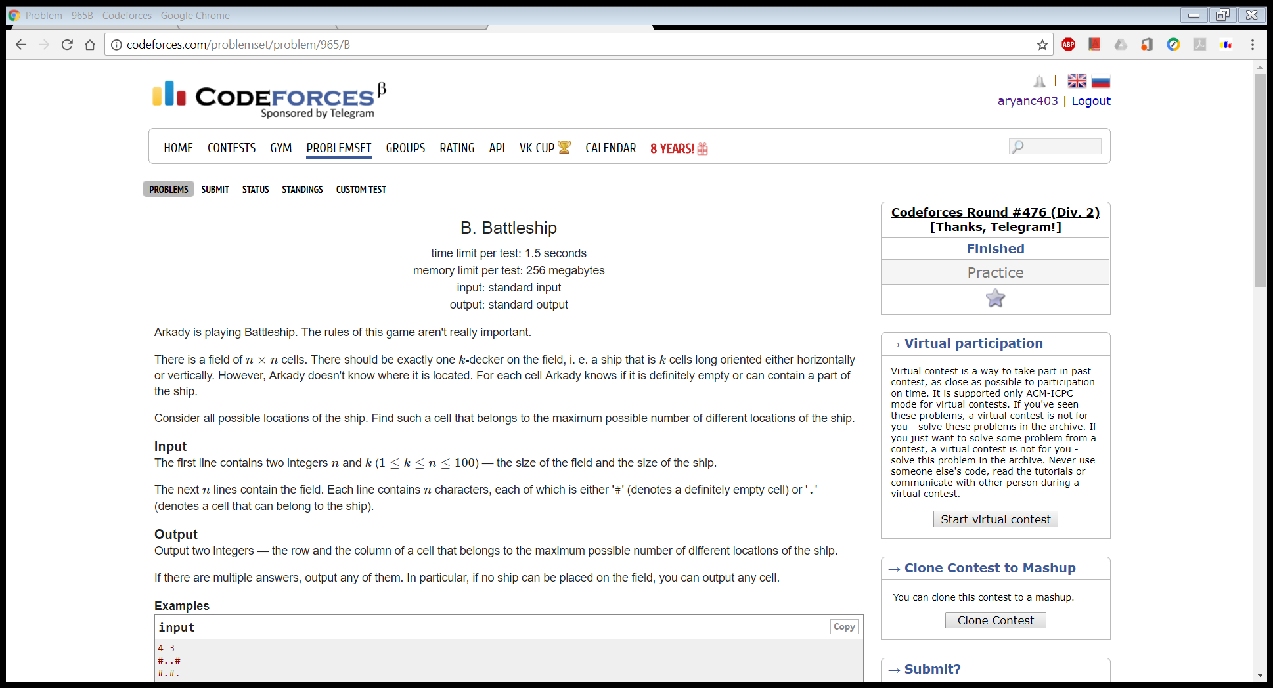

Slide 23
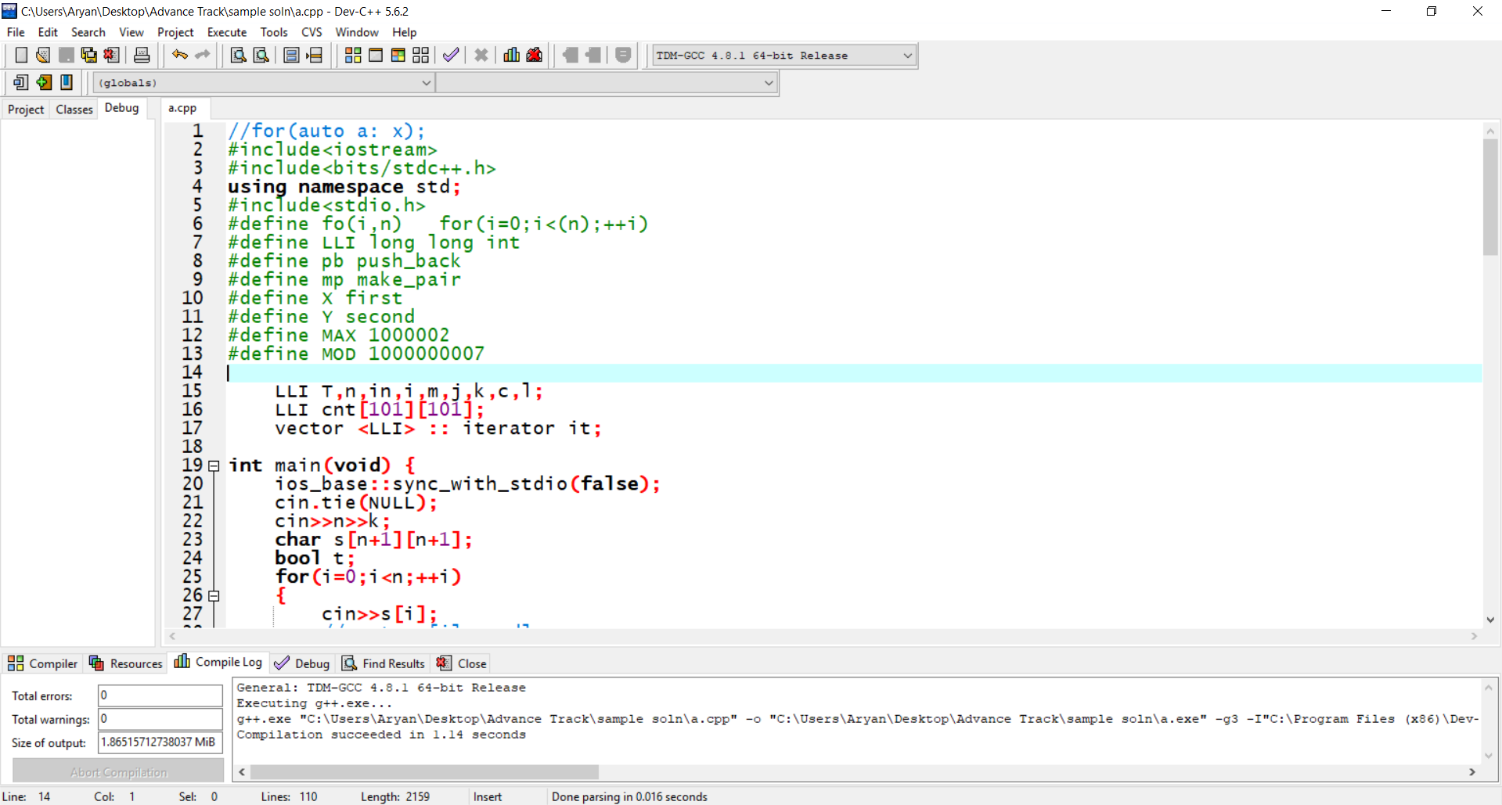

Slide 27
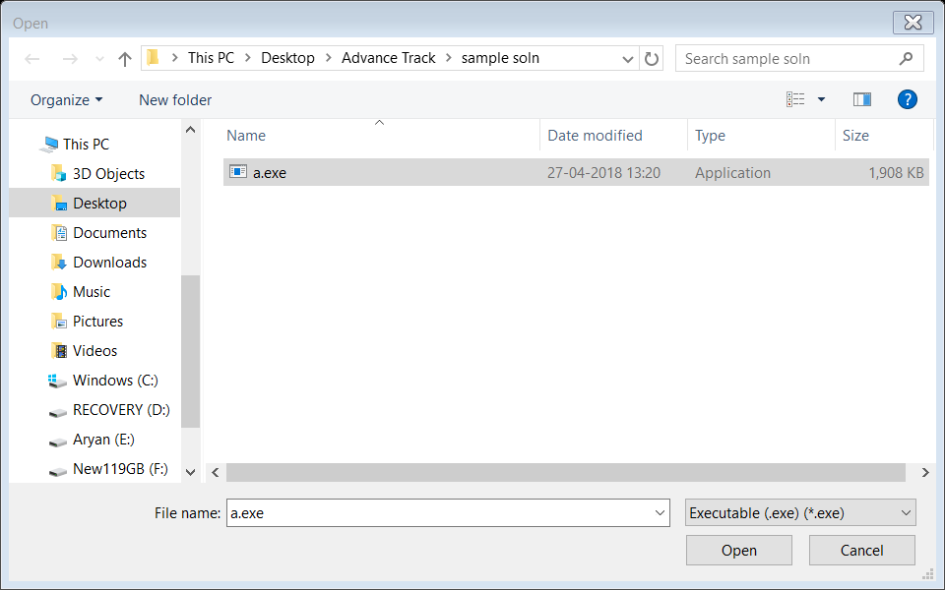

Slide 28
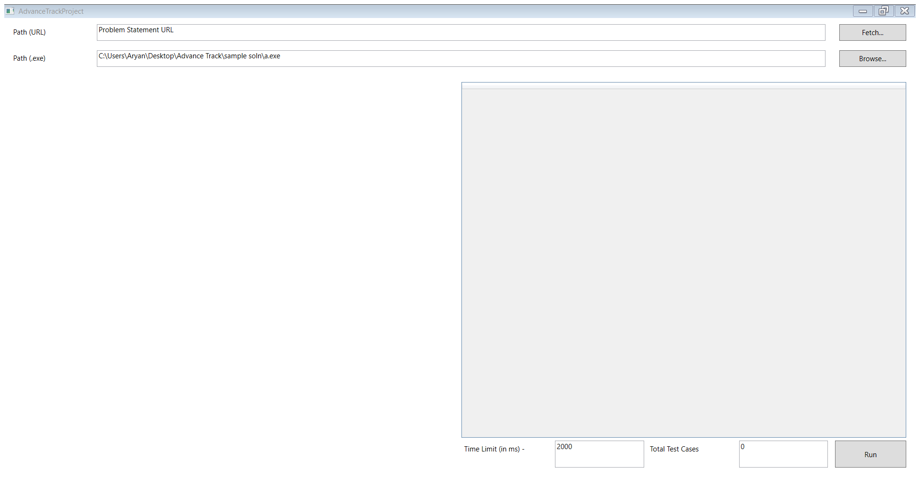

Slide 29
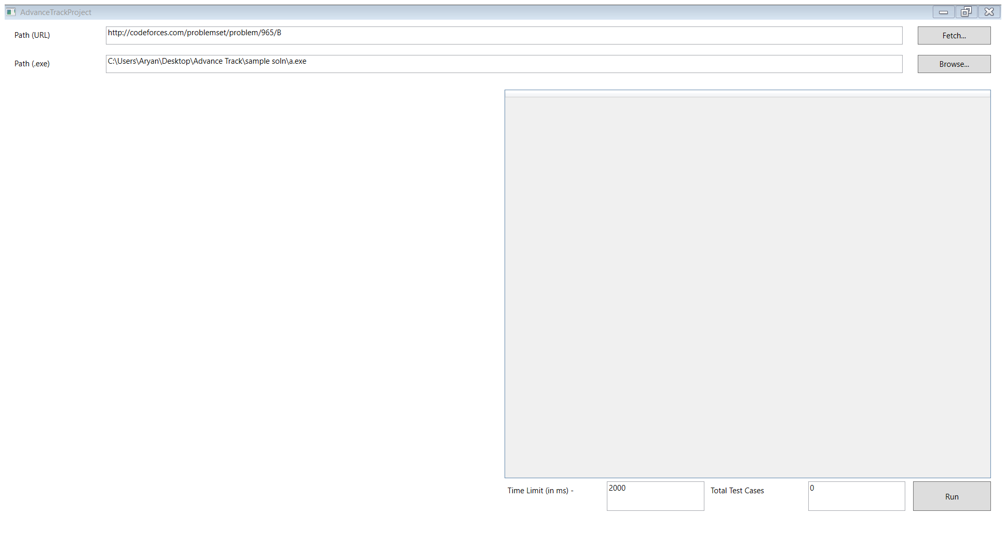

Slide 30
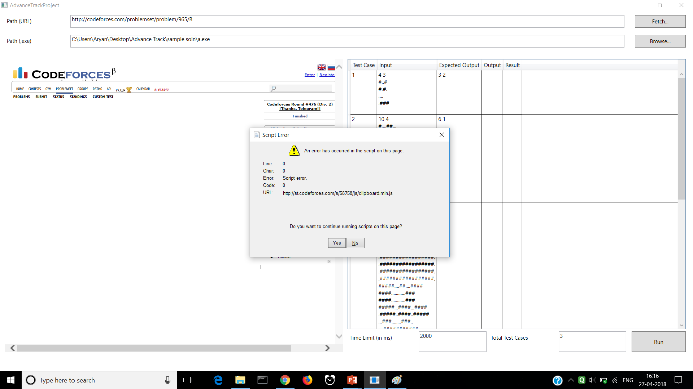

Slide 31
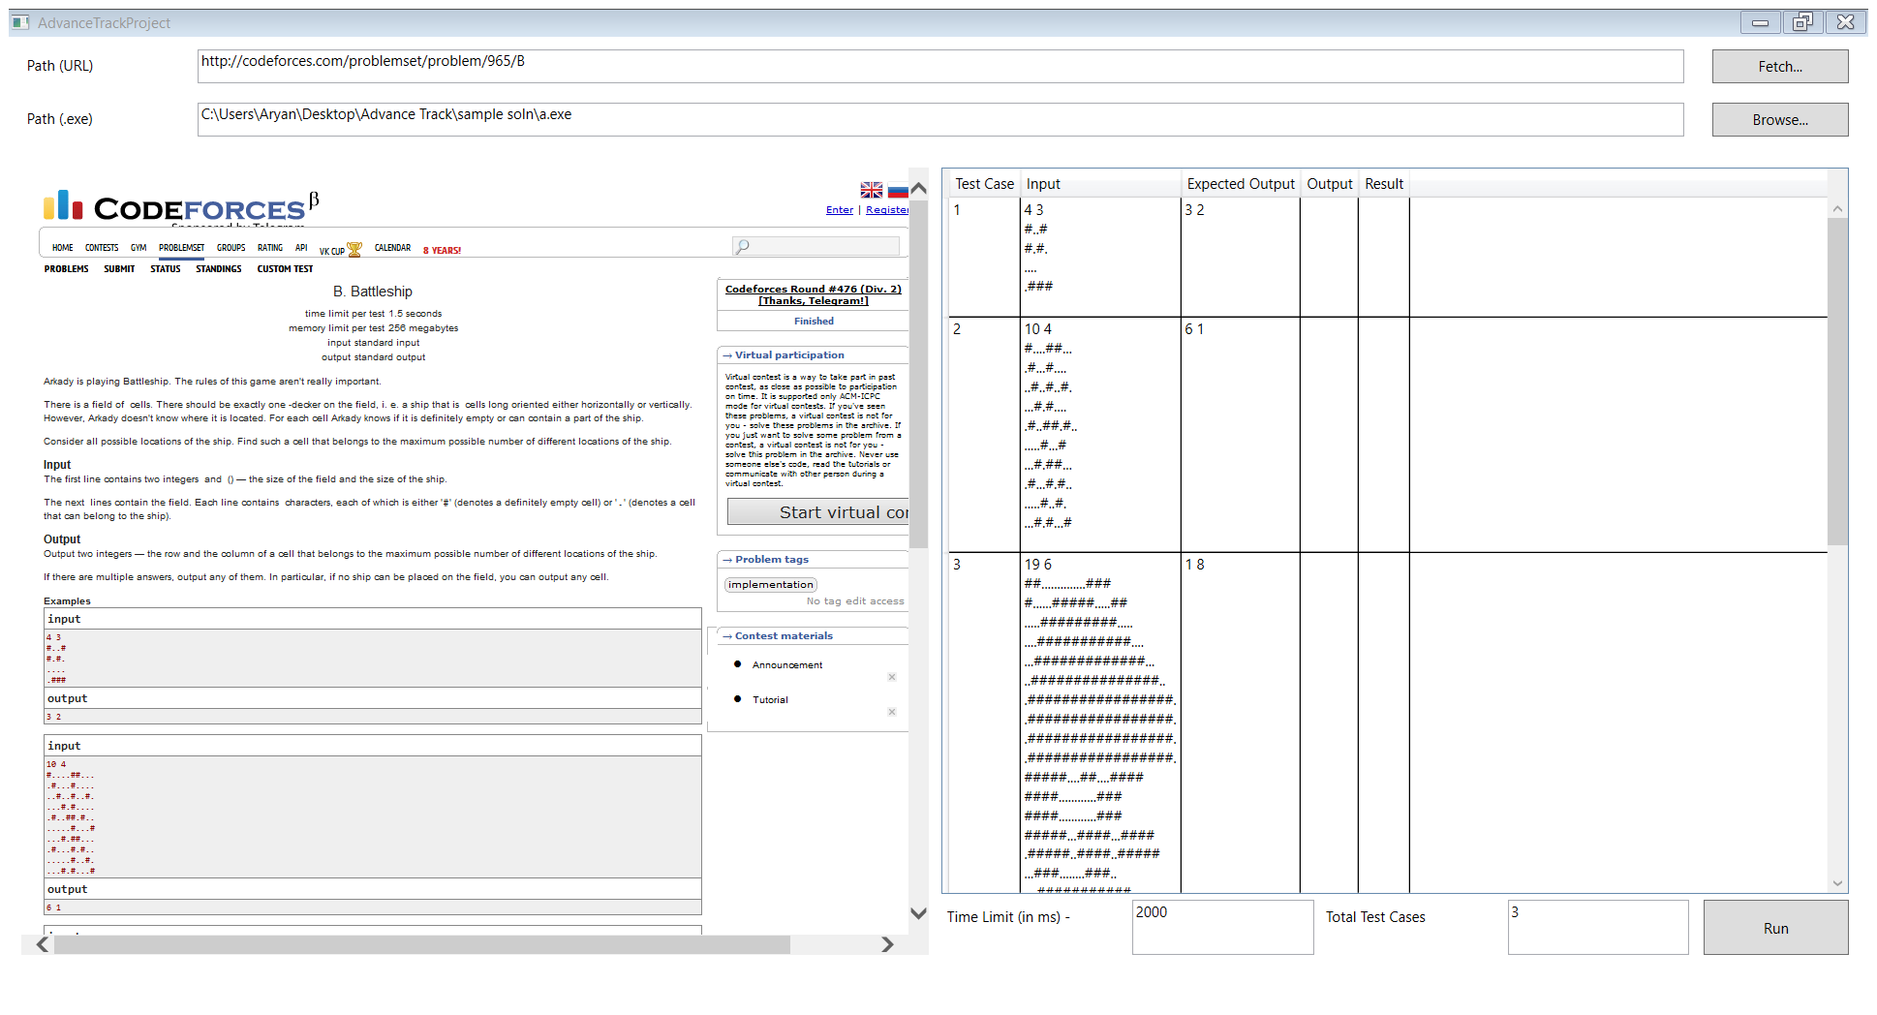

Slide 36
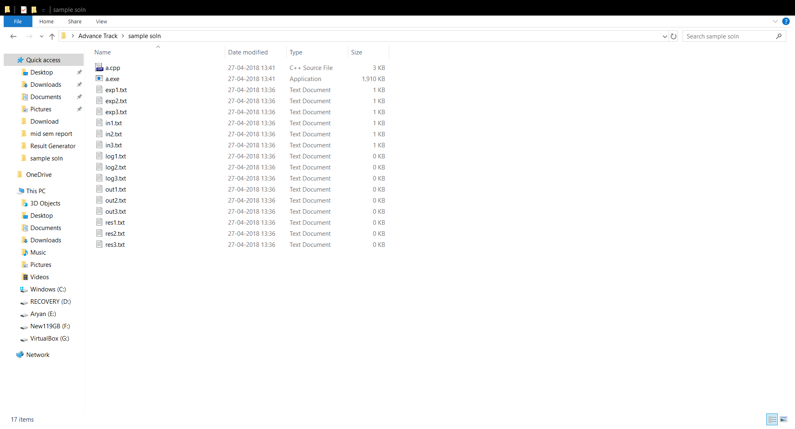

Slide 39
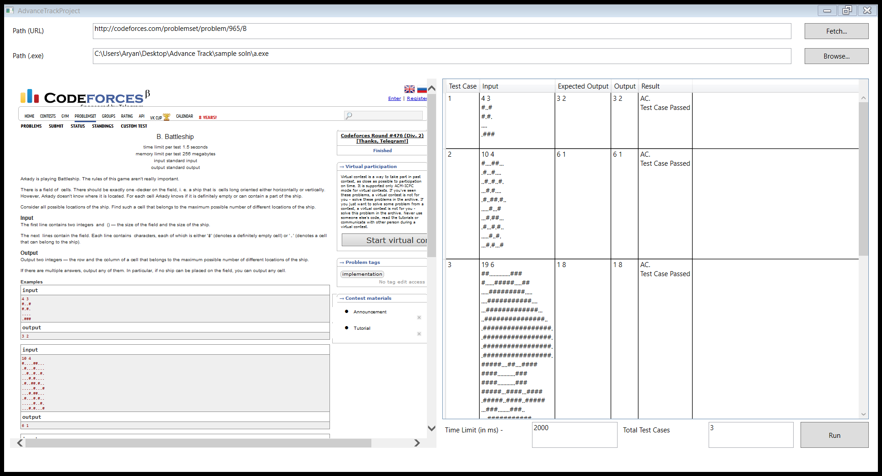

Slide 42
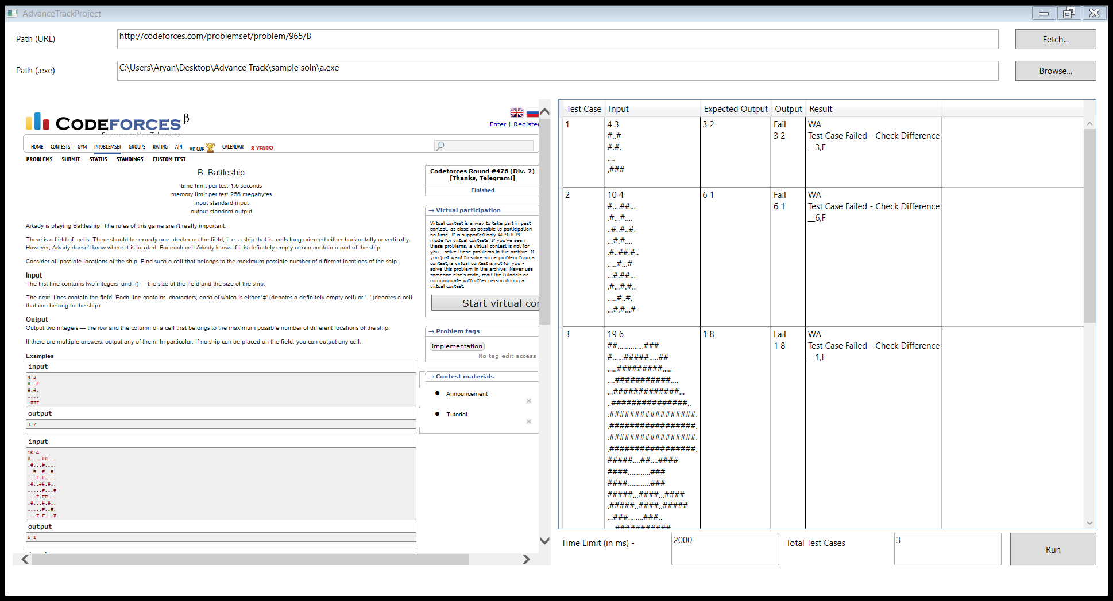

Slide 43


Slide 47
What I liked About Project !!

Slide 48
What I liked About Project !!
Making Web Scrapper.
I liked it very much.
I also created Web Scrapper to download My PHY103A assignments from course website.

Slide 49
What I liked About Project !!
Having My own software that I can use during debugging.
No more need to retype test cases during debugging of Program when solving Questions.

Slide 50
What Didn’t I like About Project

Slide 52
What Didn’t I like About Project
This error is Popping up because In back end Visual Studio uses old Internet Explorer.
I tried avoiding using three different methods.
But failed on all of them.

Slide 53

What Didn’t I like About Project
During Run Time Error.
Program gives TLE verdict.
And if someone wants to differentiate between them.
He has to look for this icon in notification panel.

Slide 54
If you had more time.

Slide 55
If you had more time.
I would have customised more.
Allowed used to edit test cases from application itself.

Slide 56
If you had more time.
One suggestion which was given to me during mid term presentation –
Add more websites.
Every Website required writing Web Scrapper from Scratch.

Slide 57
If you had more time.
Once issue with runtime error is resolved.
I would like to add so that use can know type of runtime error.
Doing this required learning signal processing at system level.

Slide 58
Thank You.

